Slide 1
The Authentication framework
in ASP.NET Core MVC
Projects

Slide 2
Introduction
Most websites or services require identifying whom is accessing the resources they provide to either:
Store information about previous interactions with the website for that user
Customize the information to the given user
Prevent unauthorized access of personal information by other party(ies)
ASP.NET Core provides a flexible framework to address this need, that allows customization as well as different integration pathways that can support:
External logins
Two-factor authentication (2FA)
Password management
Account management

Slide 3
Adding authentication
to a new ASP.NET Core MVC project

Slide 4
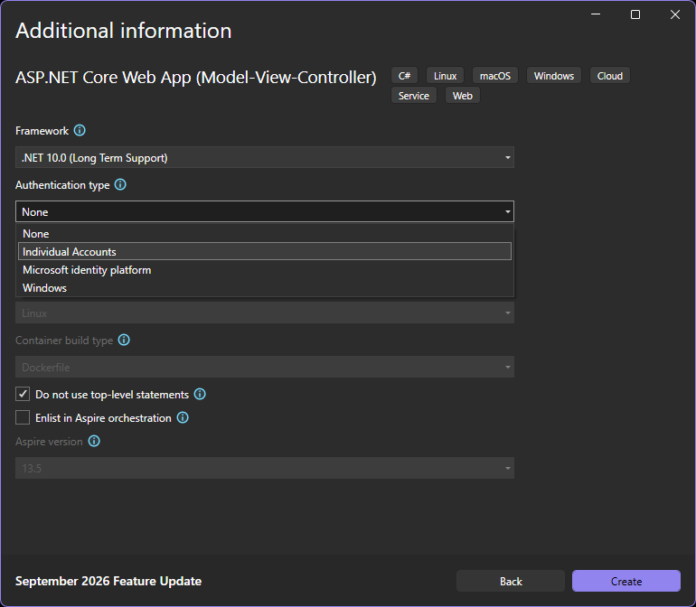
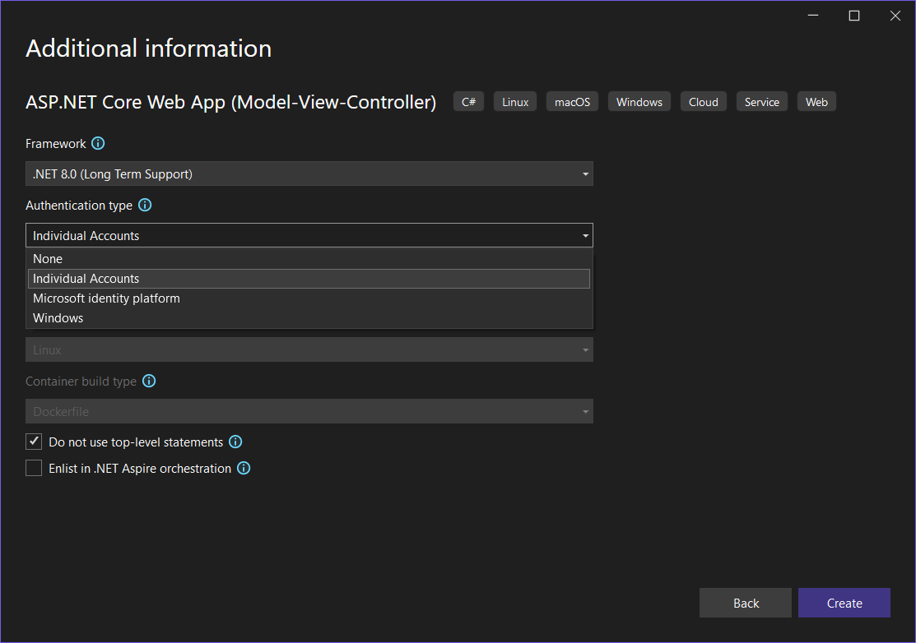
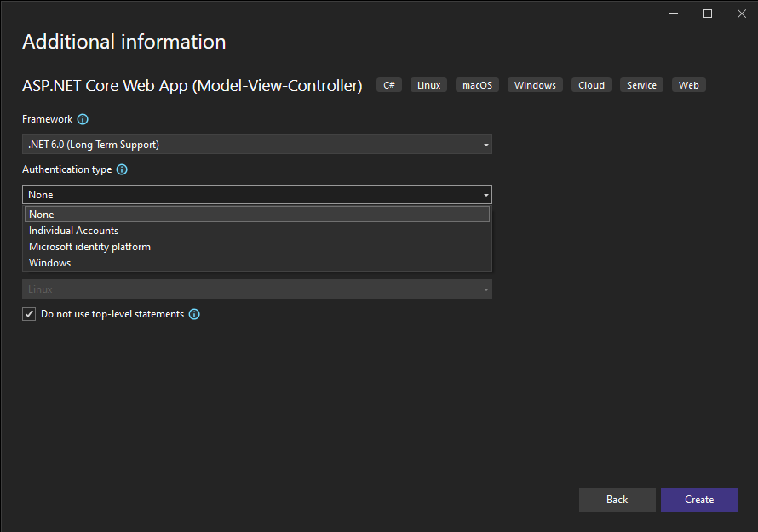
Choose your authentication type
When you create your project initially, you can choose which form of authentication to scaffold within your project:
None (which we have used previously)
Individual Accounts
Microsoft Identity Platform
Windows

Slide 5
authentication options
(explained)
Individual Accounts: stores accounts locally utilizing a configured data source. This can also be integrated with existing accounts for Facebook, X (formerly Twitter), Google, etc.
Windows: this utilizes the domain authentication framework built into windows to authenticate based upon the currently logged user (as we have seen within both SSMS and ADO.NET previously)
Microsoft Identity Platform: This utilizes the centrally managed identity platform that drives all of Microsoft’s cloud infrastructure, which allows for very easy scaling and diverse management.

Slide 6
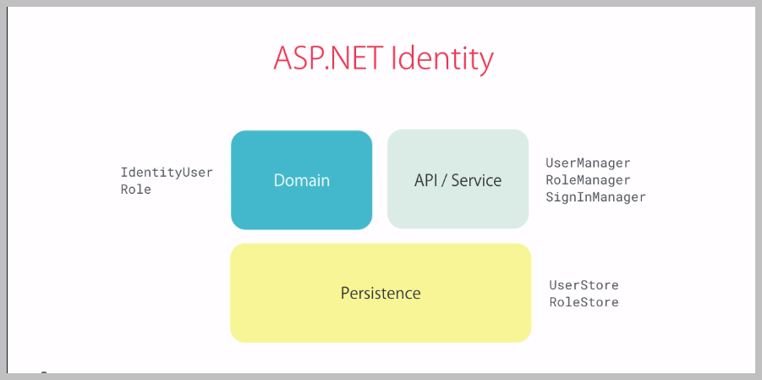
ASP.NET Core Identity classes

Slide 7



Asp.net core projects
(scaffolding – what happens behind the scenes)
authentication
Nuget packages
Project configuration
We are now choosing different options for our initial project creation from previous projects.
This is changing the structure of our project from how we have seen previously
Explore the Solution Explorer to see which areas are different (or new)
Previously we have had projects initially have no NuGet Packages upon creation.
We have had to add features ourselves and configure them within our projects
Review which packages are present (and pay attention to the details)
We defined specific components of our project configuration for ensuring the project persisted information correctly
Review the configuration to see the initial version (and make adjustments as necessary)

Slide 8
Implementing authorization
(how its managed)
Identifying which areas of our project require specific forms of authentication (and how particular) is managed using a familiar mechanism : [Data Annotations]
These are made available to use within our Controller classes when we access the namespace Microsoft.AspNetCore.Authorization
Access is defined at the level of our Controllers and the Action methods that they are comprised of. We can modify this access

Slide 9
Anonymous access
(ALL ARE WELCOME)
[Authorize] disables anonymous access on a controller (for all actions on the entire controller) or specific controller actions.
You can indicate [AllowAnonymous] on specific actions as well, if it was forbidden on the entire controller
(It is possible to configure our project to require authorization is applied GLOBALLY (unless we specify otherwise) – this will be shown within a future demonstration)

Slide 10
Restricting access
(for authorized users only)
[Authorize] (must be logged in)
  Apply to individual actions within a controller, to an entire controller, or globally (using AuthorizeFilter)
  Authorize can be role-specific:
    [Authorize(Roles=“Admin”)]
  Note: Role-driven Authorization will be explored in the future
Within an action example:
if (User.Identity.IsAuthenticated) { // perform Business Logic}
if (User.IsInRole(“Admin”)) { // perform Business Logic}

